Slide 1
MARINE CORPS UNIVERSITY COLLEGE OF DISTANCE EDUCATION AND TRAINING
CAMP PENDLETON REGION

Slide 2
Camp Pendleton Region
MWTC Bridgeport
CALIFORNIA
Los Angeles
MCB Barstow
MCB Camp Pendleton
MCB 29 Palms
San Diego

Slide 3
Camp Pendleton Region Staffing
Government
GS-14 Regional Director Mr. Chet Jolley (Col USMC Ret)
Blended Seminar Chief Instructor LtCol Eddie Utuk
Blended Seminar Instructor TBD
Davis Defense Group – Distance Education Program
Command & Staff Mr. Jack Hall (Col USMC Ret)
Expeditionary Warfare School Mr. Jim Woulfe (LtCol USMC Ret)
Enlisted Seminar Program Mr. Harrison Tanksley (SGTMAJ USMC Ret)
Enlisted Seminar Program Mr. Rob Hightower (SGTMAJ USMC Ret)
Administration Assistant Ms. Kerrie Parsons
Administration Assistant Ms. Monica Castillo
Davis Defense Group – Blended Seminar Program
Command and Staff Instructor Mr. Hank Donigan (Col USMC Ret)
Command and Staff Instructor Mr. Mark Desens (Col USMC Ret)
Expeditionary Warfare Instructor Mr. Willie Buhl (Col USMC Ret)
Expeditionary Warfare Instructor Mr. Stefen Bien (Col USMC Ret)
Expeditionary Warfare Instructor Mr. Will Kronister (LtCol USMC Ret)
Course Director Mr. Tye Wallace (Col USMC Ret)

Slide 4
Marine Corps University College of Distance Education and Training
Officers
Expeditionary Warfare School (grade O2/O3)
Distance Education Program (2 year program - weekly seminar or online)
Enrollment starts in July and January for the two semesters; open to SNCOs w/waiver
Blended Seminar Program (4 weeks resident, 12 weeks online, 6 weeks resident)
Two courses a year starting July and January; Review MARADMIN for eligibility
Command & Staff College (grade O3/O4)
Distance Education Program (2 year program - weekly seminar or online)
Enrollment starts June for year one and year two
Blended Seminar Program (4 weeks resident, 28 weeks online, 6 weeks resident)
Two courses a year starting July and January; Review MARADMIN for eligibility
Enlisted
Three cycles a year – starting July, November, March
Sergeants Course, Career Course, Advanced Course – all Seminars all 15 weeks
Contact MCU CDET Camp Pendleton Regional Office for information
EMAIL: cdet_camppendleton@usmc.mil PHONE: 760-725-8400

Slide 5
Enlisted College College of Distance Education and Training Marine Corps University

Slide 6
Enlisted Professional Military Education
(Distance Education Program (DEP) Options)
SEPME
School
Keystone
Seminar
Sergeants
School DEP
Pre-Work (Req)
Career
School DEP
Pre-Work (Req)
Advanced
School DEP
Pre-Work (Req)
SEJPME
SgtMaj/
MGySgt
Symposium
Leading
Marines DEP
Pre-Work (Req)
Corporals
School DEP
Pre-Work (Req)
1stSgts (only)
Seminar
(Req)
Sergeants
School
Seminar
Career
School
Seminar
Advanced
School
Seminar
SgtMaj
Seminar
(Req)
Command Sponsored Cpl Seminar
OR
OR
OR
Command
Sponsored
LCpl Seminar
Sergeant
School
Resident
Career
School
Resident
Advanced
School
Resident
E8 Seminar
(Req)
LCPL
CPL
SGT
SSGT
GYSGT
1STSGT / MSGT
SGTMAJ /
MGYSGT
CDET offers these Seminars
Notes:
Updated Enlisted PME MARADMIN 521/14 (16 Oct 2014)
The Corporals Course DEP became available in Feb 2012. Beginning in October 2013, completion of either the DE Corporals Course or the Command Sponsored Corporals Course will be required for promotion to Sergeant.

Slide 7
Distance College Construct
Distance Education and Training is equal for promotions & assignments ref. MCO 1553.4B
Curriculum is representative of the SNCOA curriculum
DEP is designed to support Marines who:
Can not attend SNCOA due to limited seat availability
Circumstances prevent attending the SNCOA
Alleviates unit manning concerns

Slide 8
CDET Program Administration
Commander’s will screen/certify their Marine’s eligibility
Same command screening checklist as SNCOA (NAVMC 11580)
CDET does not verify command screening information
Disciplinary/academic issues are passed back to the Command
Sign up via MarineNet
CDET Seminars are demand driven
Offered three times a year per the MARADMIN
Notes:
These control measures were added to ensure that units still maximize resident seats available at the four SNCO Academies that run Career Courses.

Slide 9
EC DEP Academic
15 week seminar (3 hour seminar X 15 weeks); 1800-2100
Facilitated through web based educational technology
Socratic and lecture; experiential and student centered
Synchronized across the USMC
Adjunct faculty
Senior SNCO that has completed CCRS, ACRS, EWS or CSCDEP
Certified and faculty developed by CDET
Weekly Battle Rhythm
Complete readings, take quiz before seminar, participate in discussions/learning activities, take exam/submit written requirements = 5 hours of effort/week ICO day job
Grading construct - 20% Quiz/40% participation/40% written assessments
Distinguished graduate awarded per class

Slide 10
Officer - College of Distance Education and Training
Expeditionary Warfare School
Command and Staff College

Slide 11
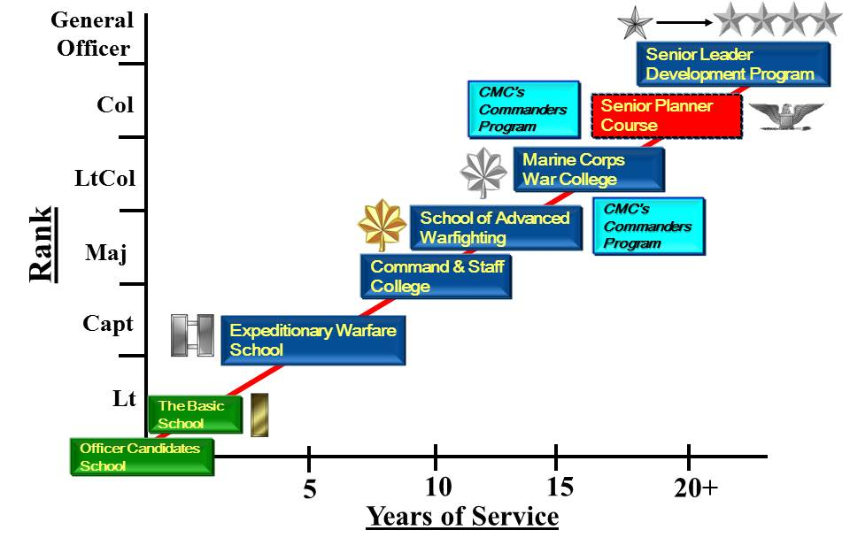
Officer
Professional Military Education
Seminar Available
Seminar Available

Slide 12
OPME Options
Career Level School
Resident EWS or Army Advanced Course
EWS Blended Seminar Program (CDET)
EWSDEP evening seminar (CDET)
Intermediate Level School
Resident CSC or other Service equivalent school
Blended Seminar Program (CDET)
CSCDEP evening seminar (CDET)
“Equal for promotions & assignments”
MCO 1553.4B
Notes:
See MARADMIN 210/20 for information on Blended Seminar Program

Slide 13
CSCDEP
First Year
Sep
May
Theory & Nature
Of War
8901
9 weeks
National and
International Security
Studies
8902
9 weeks
Joint Operations
8904
9 weeks
Operational
Art
8903
8 weeks
Second Year
May
Sep
Small Wars
8905
8 weeks
MAGTF Exp Ops
8906
10 weeks
The FMF and Naval
Exp Ops
8907
6 weeks
Operational Planning
8908
11 weeks
Majors/CWO4s and Capt w/36 months TIG / CWO3s w/24 months TIG
2 year program: evening seminar (once a week / 2 – 3 hrs)
Integrates with other regions (TAD)

Slide 14
EWSDEP Program
2 year program
8670 Foundations
EWSDEPPREQ - (Self-study)
Sign up via MarineNet
Warfighting
8671
Functional Employment of the
MAGTF
8672
Weekly seminar with instructor
Utilizes MarineNet/Moodle
4 month course offered twice a year
Sep – Jan / Feb - May
MAGTF Operations
8673
MAGTF Operations
Practical Exercise
8674
1stLt’s, Capt’s and CWO2/3’s eligible – E-7 and above with waiver
Notes:
8670 pre-course must be completed prior to requesting enrollment in 8671; average time to complete the pre-course is six weeks.

Slide 15
What is the Blended Seminar Program?
Complete EWS in 6 months, CSC in 8 months
Combination of resident and online
Initial Resident Period - 4 weeks
Non Resident Period - 28 weeks (CSC)/ 12 weeks (EWS) online
Final Resident Period - 6 weeks
Resident periods includes curriculum similar to DEP with additional content including guest speakers and field trips extra practical exercises
See MARADMIN for more details
Notes:
CMC memo dated 15 April 2012

Slide 16
Point of Contact Information
Regional Director Mr Chet Jolley
Chester.Jolley@usmc.mil
BSP LtCol Eddie Utuk
Eddie.utuk@usmcl.mil
Admin Assistant OPME Ms. Kerrie Parsons
parson@davisdefense.com
Admin Assistant EPME Ms. Monica Castillo
castillom@davisdefense.com

